Slide 1

Notes:
1st slide (Mandatory)

Slide 2

Graph Coloring
What is graph coloring problem how can you solve it?
Graph coloring is the procedure of assignment of colors to each vertex of a graph G such that no adjacent vertices get same color.
The objective is to minimize the number of colors while coloring a graph.
The smallest number of colors required to color a graph G is called its chromatic number of that graph
Graph coloring problem is to assign colors to certain elements of a graph subject to certain constraints.

Slide 3
Vertex coloring is the most common graph coloring problem. The problem is, given m colors, find a way of coloring the vertices of a graph such that no two adjacent vertices are colored using same color. The other graph coloring problems like Edge Coloring (No vertex is incident to two edges of same color) and Face Coloring (Geographical Map Coloring) can be transformed into vertex coloring.
Chromatic Number: The smallest number of colors needed to color a graph G is called its chromatic number. For example, the following can be colored minimum 2 colors.

Slide 4
The problem to find chromatic number of a given graph is NP complete
Applications of Graph Coloring:
The graph coloring problem has huge number of applications.
Making Schedule or Time Table
Mobile Radio Frequency Assignment
Register Allocation
Bipartite Graphs
Map coloring

Slide 5
Basic Greedy Coloring Algorithm:
1. Color first vertex with first color.
2. Do following for remaining V-1 vertices.
a) Consider the currently picked vertex and color it with the lowest numbered color that has not been used on any previously colored vertices adjacent to it. If all previously used colors appear on vertices adjacent to v, assign a new color to it.
https://www.geeksforgeeks.org/graph-coloring-set-2-greedy-algorithm/?ref=lbp

Slide 6
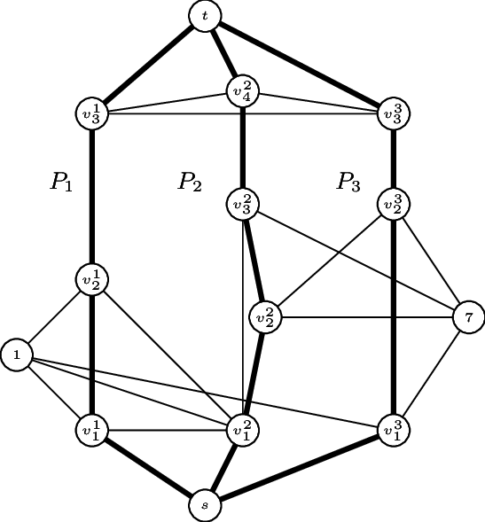

Slide 7

THANK YOU

